Slide 1
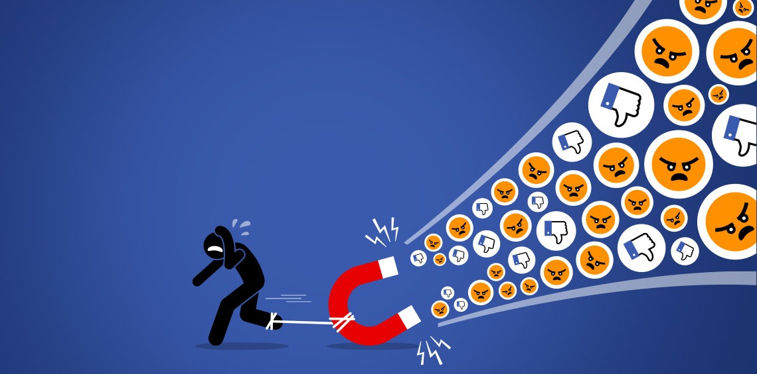
CHURN PREDICTION

Slide 2





Business Problem
CHURN PREDICTION ON E-COMMERCE
Identifying at-risk customers.
Implementing proactive strategies to retain them.
Ensuring sustained revenue and long-term
customer loyalty.

Slide 3
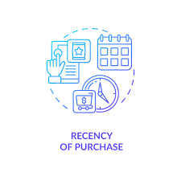




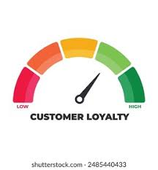

Insights
Churn prediction based on Recency:
High recency values.
Engagement Opportunities:
Many interactions but few purchase (low spending)
Loyalty Program Adjustment:
Low loyalty scores.
High LTV customers at risk of churn:
High total spend (high monetary_value)
high recency and low loyalty

Slide 4
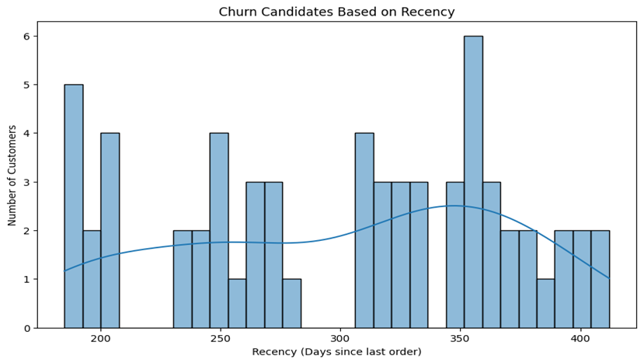
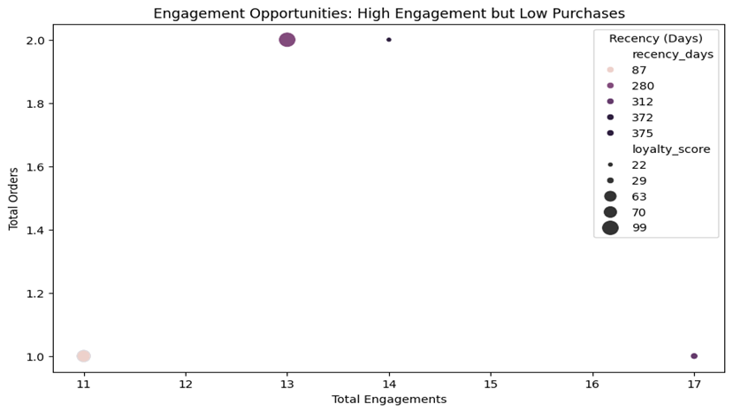
Visualization:
Churn prediction based on Recency:
Engagement Opportunities:
Retention Strategy:
Re-engagement Campaign with Limited-Time Offers
Retention Strategy:
Targeted Conversion Tactics

Slide 5
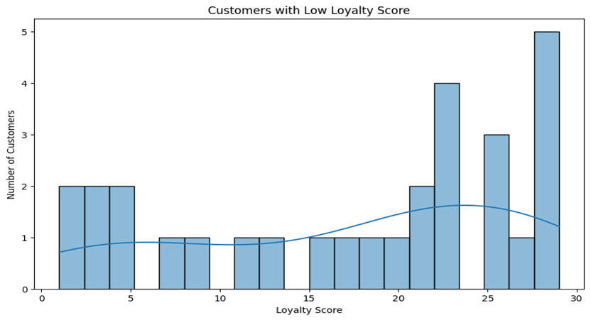
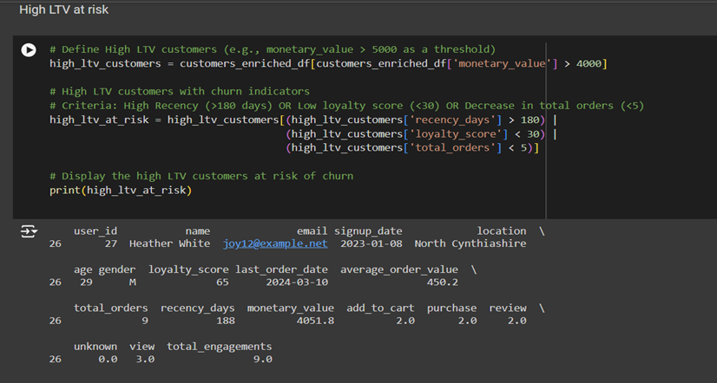
Visualization and Code Snippet
Loyalty Program Adjustment:
High LTV customers at risk of churn:
Retention Strategy:
Loyalty Enhancement Program
Retention Strategy:
Treat like VIPs.

